Slide 1

NET Ambition Make Learn Easy
www.netambition.net
Online Classes For NET & JRF and other Computer Science Subjects
Faculty: Amit Sagu
2 X NET, JRF, HTET, Ph.D. Pursuing (IoT, Machine Learning), M.Sc. (CS)
Call or WhatsApp:
9467702051

Slide 2
.NET Architecture

Slide 3
.NET
designed and developed by Microsoft and the first beta version released in 2000.
The first version of the .Net framework was released in the year 2002

Slide 4
Goals and Applications
Web Applications
Windows Applications
phone Applications

Slide 5
Salient Features
Less Coding and Increased Reuse of Code
Reliability
Security
Language Interoperability
Deployment

Slide 6
11 Programming Languages which are designed and developed by Microsoft are:
C#.NET
VB.NET
C++.NET
J#.NET
F#.NET
JSCRIPT.NET
WINDOWS POWERSHELL
IRON RUBY
IRON PYTHON
C OMEGA
ASML(Abstract State Machine Language)

Slide 7

IDE
Visual Studio is a very powerful Integrated Development Environment (IDE) where we actually write our C# or .NET programs. It is popular because it supports code editing, interface design, server management, debugging, and performance analysis. We can download Visual Studio for free.

Slide 8
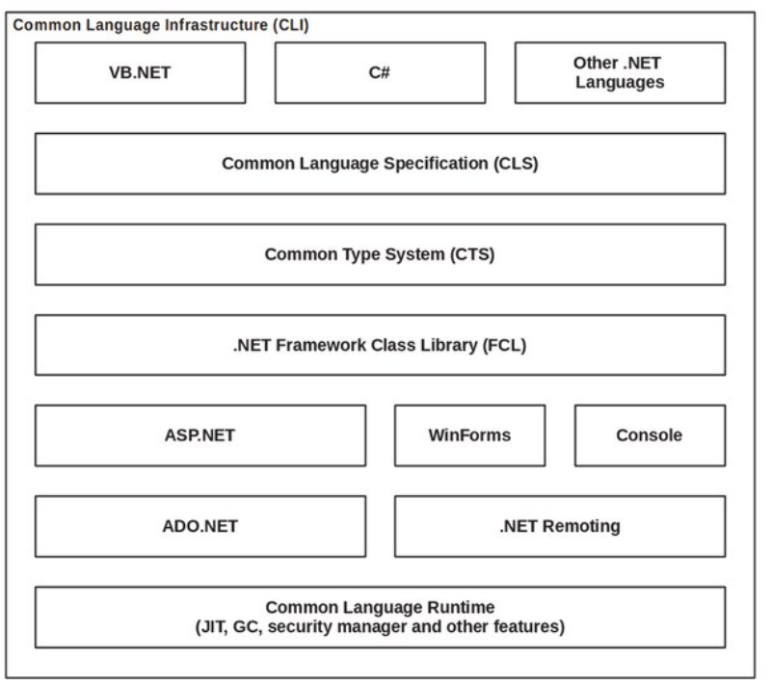

Slide 9
.NET Architecture
Language
WinForms, ADO.NET, ASP.NET,
Library
Framework Class Libraries ( FCL )
Common Language Runtime
Common Language Runtime ( Execution Engine )

Slide 10
Language
The types of applications that can be built in the .NET framework is classified broadly into the following categories :
WinForms
ASP.NET
ADO.NET
This is used for developing Forms-based applications, which would run on an end user machine
This is used for developing web-based applications, which are made to run on any browser such as Internet Explorer, Chrome or Firefox. (Active Server Page)
This technology is used to develop applications to interact with Databases such as Oracle or Microsoft SQL Server (ActiveX Data Object)

Slide 11
Library
A class library is a collection of methods and functions that can be used for the core purpose.
e.g. -
class library with methods to handle all file-level operations. So there is a method which can be used to read the text from a file. Similarly, there is a method to write text to a file.

Slide 12
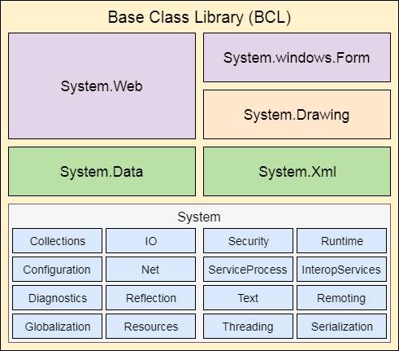
Library
FCL (Framework Class Library)
The BCL (Base Class Library) is the core of the FCL and provides basic functionalities.

Slide 13
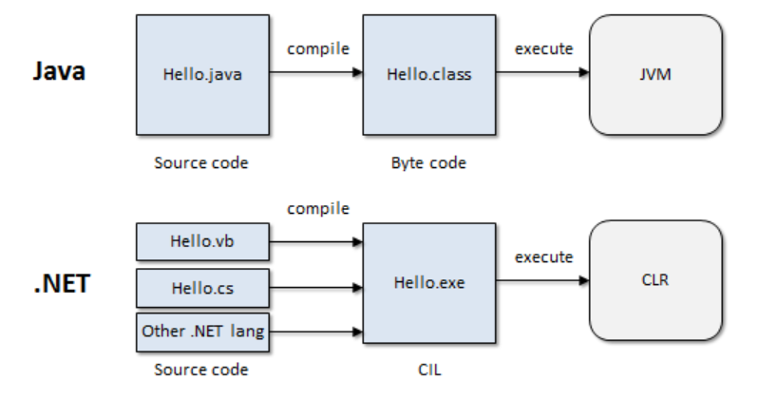
Common Language Runtime (CLR)
It is a program execution engine that loads and executes the program. It converts the program into native code. It acts as an interface between the framework and operating system.

Slide 14
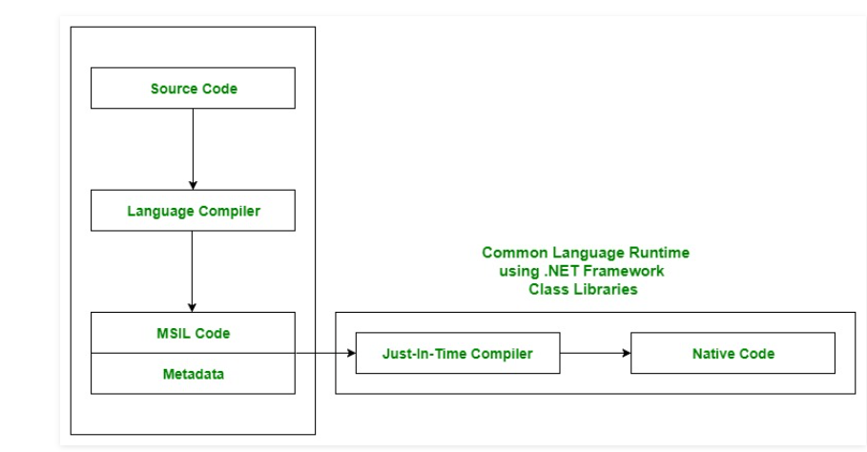

Slide 15
Suppose we have written a C# program and save it in a file.
Language specific compiler compiles the source code into the MSIL(Microsoft Intermediate Language) which is also know as the CIL(Common Intermediate Language) or IL(Intermediate Language) along with its metadata.
Metadata includes the all the types, actual implementation of each function of the program. MSIL is machine independent code.
Now CLR comes into existence. CLR provides the services and runtime environment to the MSIL code. Internally CLR includes the JIT(Just-In-Time) compiler which converts the MSIL code to machine code which further executed by CPU.

Slide 16
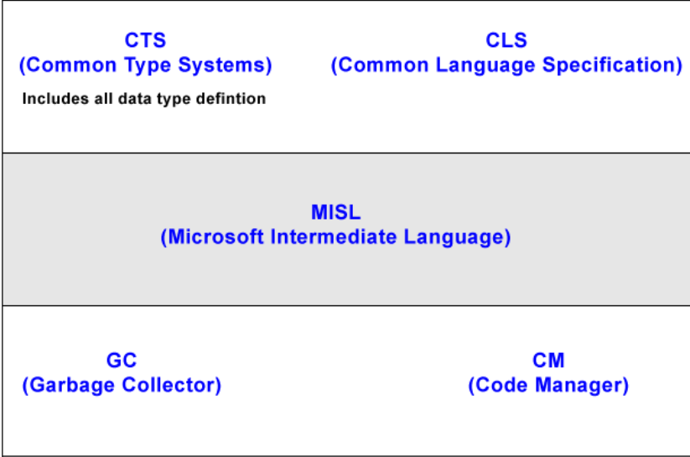
Architecture of CLR

Slide 17
Common Language Runtime (CLR)
Main components of CLR:
Common Language Specification (CLS)
Common Type System (CTS)
Garbage Collection (GC)
Just In – Time Compiler (JIT)

Slide 18
Common Language Specification (CLS) : It is responsible for converting the different .NET programming language syntactical rules and regulations into CLR understandable format. Basically, it provides the Language Interoperability.
Common Type System (CTS) :Every programming language has its own data type system, so CTS is responsible for understanding all the data type of system.
Garbage Collection (GC): It is used to provide the Automatic Memory Management feature.
Just In – Time Compiler (JIT) : It is responsible for converting the CIL(Common Intermediate Language) into machine code or native code using the Common Language Runtime environment.

Slide 20
.Net Framework Design Principle
Interoperability
Portability
Security
Memory management
Simplified deployment

